Slide 1
DATAQUEST 3.0
ROUND 1
OFFICIAL PARTICIPANT PPT TEMPLATE
PROJECT DETAILS
TEAM & MEMBERS
PROJECT TITLE
PRISM Engine
ONE-LINE PITCH
Multi Dimensional STEAM Career Guidance & Hyper-local Innovation Platform
TRACK
AI-based career guidance system
TEAM
Kanimangalam
PARTICIPANTS
• Gowtham Chakrapani H – 26BRS1103
• Gautham Kesav K – 26BME1113
• Goutham Lijin – 26BAI1533
• Abhinavdath K S – 26BCE1394
• Bevel M Joseph – 26BCE1431
• Hidhash N P – 26BQC1025

Slide 2
DATAQUEST 3.0 · ROUND 1
02 Problem Definition
Who is impacted · Today's workarounds · Why current methods fail · Concrete proof
01 · AUDIENCE
02 · STATUS QUO
WHO & HOW OFTEN
Who: Students, parents, educators and career counsellors.
How often: Students make career decisions at times like after finishing Class 10 after finishing Class 12 while in college and before graduating. Students also often need information, about job demand, salaries, scholarships, entrance exams and career opportunities.
CURRENT APPROACH
Today career planning is mostly done by searching the internet talking with career advisers looking at college websites checking ranking sites and listening to parents, teachers and friends. Students must hand‑check courses, colleges, salaries, job demand, entrance tests, scholarships and fees, from many different places. These ways take a lot of time feel broken up and usually ignore the students’ interests the family’s money and the current needs of the job market all together. Career planning should look at all those things at once.
03 · DEFICIENCY
04 · VALIDATION
WHY IT FALLS SHORT
The current approach takes a time feels broken up and is hard to tailor for each person. Students must. Compare data from many sources, which can cause students to receive old or missing information and make poor career choices.
It also does not efficiently combine student interests, money limits, local job demand, salaries and scholarships, in a system making the whole process difficult to grow and tailor for each student.
EVIDENCE
42.6% of Indian graduates were found to be ready for work according to Mercer | Mettl’s 2025 Graduate Skill Index using data from more than 1 million students across 2,700 campuses.
A 2024 IC3 Institute survey showed that 25% of students in India did not have access to career counselling and another 7% did not have counselling support.
These results show a gap between what is taught in schools what students need for their careers and what the job market requires. This supports the need for a career-planning system, like PRISM that is tailored to each person.

Slide 3
DATAQUEST 3.0 · ROUND 1
03 Proposed Solution
System identity · End-to-end user workflow · Competitive advantages
SOLUTION CORE
PRISM
PRISM is a career guidance tool that uses intelligence. It looks at what students are good at and what they like. It also considers what their families need. It checks ways to get an education. It looks at what jobs are available right now. All of these things help create career paths that work for students. These paths are in science, technology, engineering, arts and math. The paths are also good, for money.
USER FLOW
1. USER INPUT
Student Profile, Parent profile, Preferences
➔
2. PROCESSING
Vectorization, Career Matching, Financial Check, Market Analysis, Career Ranking
➔
3. OUTPUT
Top Careers, Compatibility, Financial Fit, Skill Gaps, Career Roadmap
ADVANTAGE
INNOVATION
WHY IT IS BETTER
PRISM moves beyond interest-based career prediction by combining student potential, family feasibility, and real-world market demand to generate practical and future-ready career pathways.
WHAT IS DIFFERENT
Unlike conventional career guidance, PRISM doesn't just ask what a student is good at—it asks what the student is good at, what the family can support, and where the future opportunities are.

Slide 4
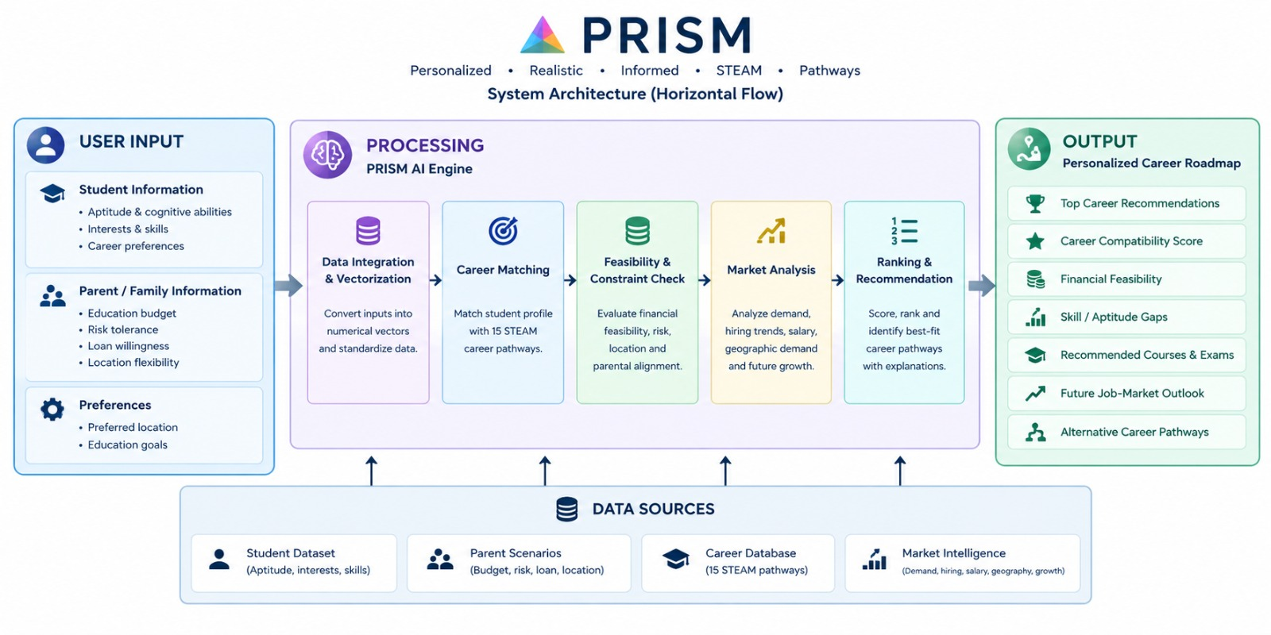
DATAQUEST 3.0 · ROUND 1
04 System Architecture
System diagram is the primary visual · Engineering decisions · Validation
SYSTEM DIAGRAM
TECH 01
TECH 02
TECH 03
KEY TECHNICAL DECISION
It takes student aptitude, family constraints, career requirements and job-market data. It uses normalized scoring and constraint checking to rank career pathways. This helps match each student with the possible career path based on their unique situation.
HARDEST PART
Combining student abilities and student interests with family constraints and shifting career‑market conditions can lead to a single clear career ranking. This single clear career ranking helps students see where they fit best.
VALIDATION
I tested student profiles and parent scenarios to check career ranking, financial feasibility and recommendation consistency. The tests were designed to confirm that career ranking remains accurate that financial feasibility is realistic, for each case and that recommendation consistency stays the same when different students and parents are involved.

Slide 5
DATAQUEST 3.0 · ROUND 1
05 Feasibility & Scope
Concrete boundaries · Operational run rate · Risk mitigation · Post-hackathon plans
01 · BOUNDARIES
02 · ECONOMICS
1. SCOPE
Expand PRISM, with real-world datasets real-time labour market information, college and scholarship recommendations and personalized AI career guidance.
2. RUNNING COST
Running Cost is low – about ₹0 to ₹1,000 per month, for the prototype. Running Cost uses open‑source tools, free data sources and lightweight cloud services.
03 · CONTINGENCY
04 · HORIZON
3. RISKS & FALLBACK
PRISM could have problems like information, wrong suggestions, new changes in the job market and not enough details, about scholarships. As a plan it will use data that is checked and updated often offer several career choices and make sure the suggestions are shown as help but not as promises..
4. AFTER THE HACKATHON
After the hackathon we want to make PRISM better by adding real-time career information, salary details, scholarship options and job market updates. We will check how good the suggestions are, by asking students and counsellors. Our goal is to turn PRISM into a career planning tool that works for students, parents, schools and colleges..

Slide 6
DATAQUEST 3.0 · ROUND 1
06 Impact & Metrics
Primary measurable impact · Transparent calculation · Stakeholder advantages
PRIMARY METRIC
[ XX% ]
[ One important measurable impact metric ]
HOW IT WAS MEASURED
We used sample student profiles and real-world career data to measure PRISM. We compared the recommendations it gave against factors, like career demand, salary, affordability and scholarship availability. The results were based on a scoring system that checked how well each suggested career aligned with the student’s interests, financial limits and what the job market actually needed..
IMPACT 01
IMPACT 02
IMPACT 03
WHAT IMPROVES
PRISM improves career decision‑making by combining student interests, family affordability, salary potential, industry demand and financial‑aid opportunities, in one system. I see PRISM help users make informed, personalized and practical career choices while reducing the risk of unsuitable or financially difficult decisions.
WHO ELSE BENEFITS
Students, parents, schools, colleges, career counsellors, and employers all benefit from PRISM by gaining better career insights, financial planning, and access to relevant skills and opportunities
RISKS / MISUSE
PRISM may give out-of-date suggestions. It could use data and mishandle personal or financial information. Users might depend much on AI advice. That is why results should be shown as help not as sure choices, for careers.

Slide 7
DATAQUEST 3.0 · ROUND 1
07 Why This Project?
Direct contrast with today's alternatives · Unfair technical advantage
STATUS QUO
OUR SOLUTION
CURRENT APPROACH
Today students use career counsellors Google searches, college websites, job portals and special scholarship and salary websites to get ready, for their careers. These choices are spread out take a lot of time. They do not often bring together personal interests, family money limits and what is needed in the job market right now all in one place.
OUR APPROACH
PRISM uses a -factor algorithm to combine student interests, skills, financial constraints, location, salary potential, scholarships and industry demand to generate personalized career paths. It brings all these factors together in one place. This makes it faster relevant and more cost-effective than comparing many separate sources by hand. Students get guidance that fits their situation without having to search over. The system looks at everything, at once. Gives clear tailored suggestions. It helps students make choices about their future careers.
MOAT / DIFFERENTIATION
KEY DIFFERENCE
PRISM is a tool that joins student interests, family affordability, job demand in the region and around the world salary potential and financial‑aid options in one decision engine.
Of having users look at each of these factors, on different sites PRISM keeps everything together so that the decision process becomes simpler and clearer.

